Slide 1
1st vr project bowling

Slide 2
AGENDA
BRAINSTORMING
Explanation
How we reached the final idea?
How is the program working?
Final outcome
Further improvements
Which is the final result?
What could we add to improve it?

Slide 3
THE IDEA
VR appealing game
Involvement of simple physics
Investigate about different topics related to the technology

Slide 4



Slide 5
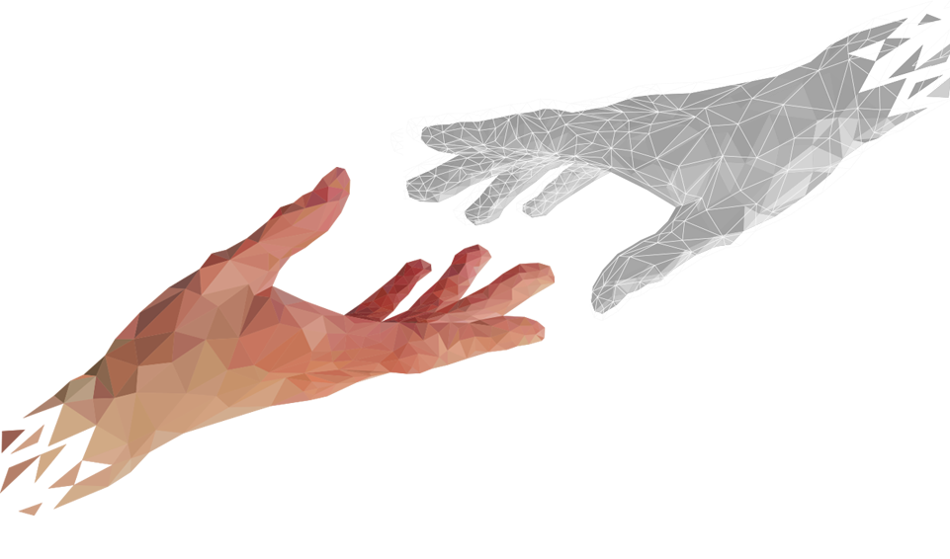
Explanation
thE OBJECTS
OTHER LOGICS
Reset
VR Hands
1 Dynamic Score
10 Pins
2 Balls
1 Alley
1 Table

Slide 6
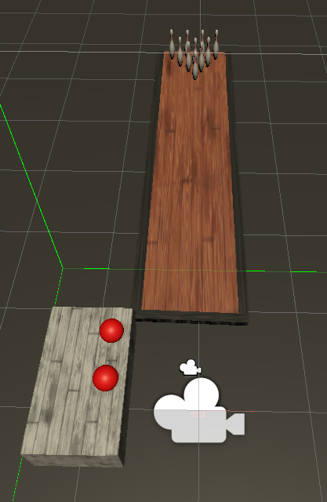

Slide 7

FINAL OUTCOME
ment en qualsevol dispositiu. Torna més tard per veure'l.

Slide 8
further improvements
Improve the design of the environment
Implement multiplayer
Implement a real bowling score
Improve the animations

Slide 9
Thanks for your attention
Tak for din opmærksomhed :)

